Slide 1
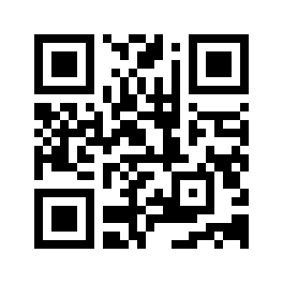

Imbalance-Aware Feature Selection and Machine
Learning for U.S. Corporate Bankruptcy Prediction
Yun-Chen Li, Rou-Rou Yu, Yi-An Chen, Huei-Wen Tung
20251013 BP.key

Slide 2
Motivation
Study Plan
Data (EDA)
Model Result
- LR (Benchmark)
- XGB
- SVM
- RF
U.S. Corporate Bankruptcy Prediction

Slide 3
Motivation
Motivation
Create a corporate bankruptcy prediction
Use high dimensional financial data
Solve class imbalance by creating synthetic samples
Use feature selection (LASSO, XGBoost)
Comparing LR, XGB, Random Forest and SVM
U.S. Corporate Bankruptcy Prediction
Notes:
美國市場

Slide 4
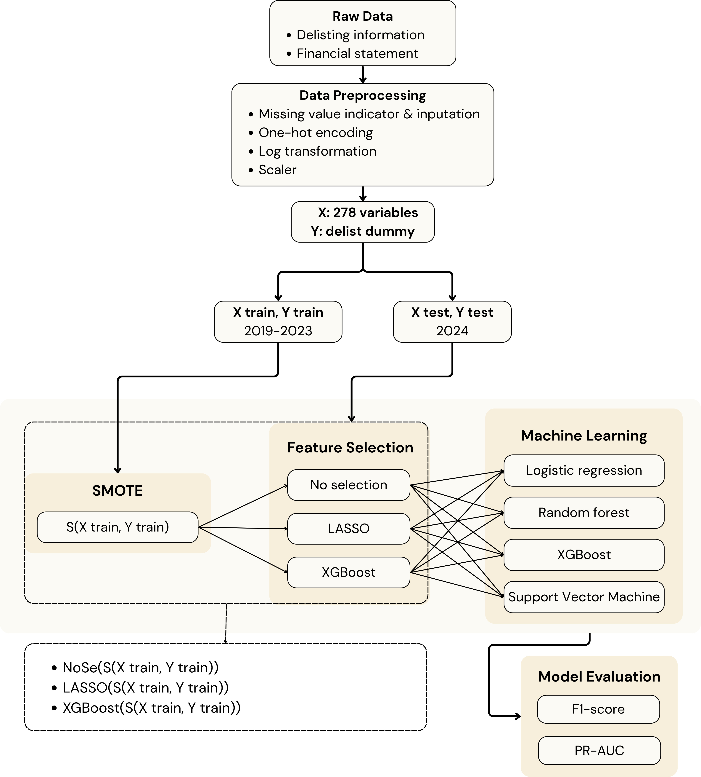
Motivation
Study Plan
U.S. Corporate Bankruptcy Prediction
Notes:
美國市場

Slide 5
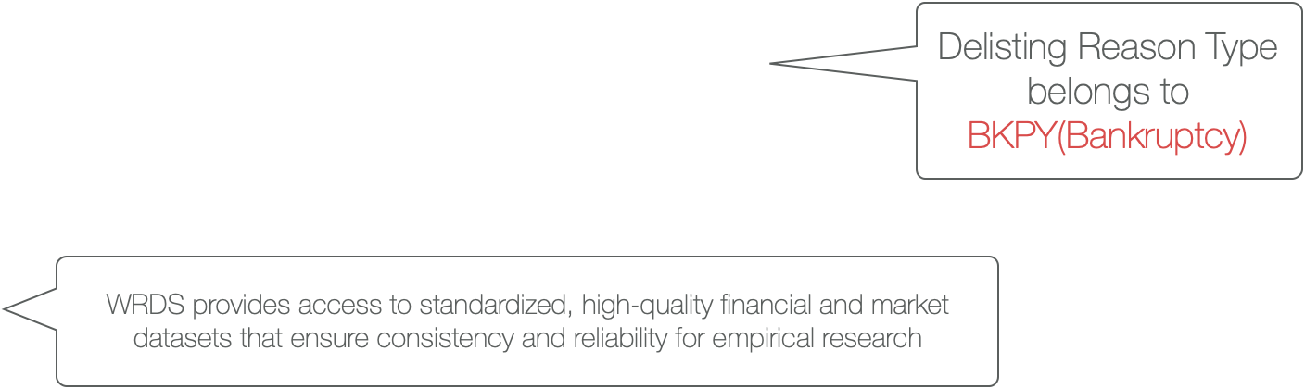

Data
Data
11475 companies
118 features
Large class imbalance
Variable type | Number of type
Categorical | 8
Text | 6
Continuous | 104
Data Information
Period | 2019/1/1-2024/12/31
Frequency | Yearly
Database
Bankruptcy | WRDS CRSP US Stock delisting information
Financial Statement | WRDS Compustat Fundamental Annual
U.S. Corporate Bankruptcy Prediction

Slide 6
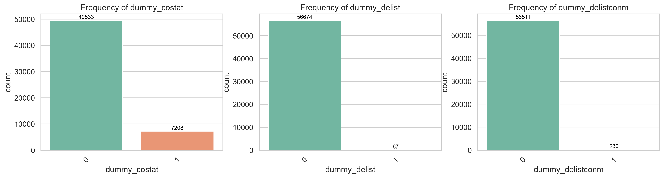
Data
Data
11475 companies
118 variables
Large class imbalance
Dummy Variable | Non-Delist Frequency | Non-Delist (%) | Delist Frequency | Delist (%)
dummy delist company | 56,511 | 99.59% | 230 | 0.41%
dummy company status | 59,533 | 87.30% | 7,208 | 12.70%
U.S. Corporate Bankruptcy Prediction

Slide 7
Data
Data pre-processing
Processing types Effects
Missing value | Fill with use the median for each variable with missing
 | Create a dummy missing indicator for each missing value
One-hot encoding | Create/convert a categorical variable into binary (0/1) feature
Log transforming | To deal with right-skewed distribution
Standard scaler | Uniform Feature Scale
U.S. Corporate Bankruptcy Prediction

Slide 8
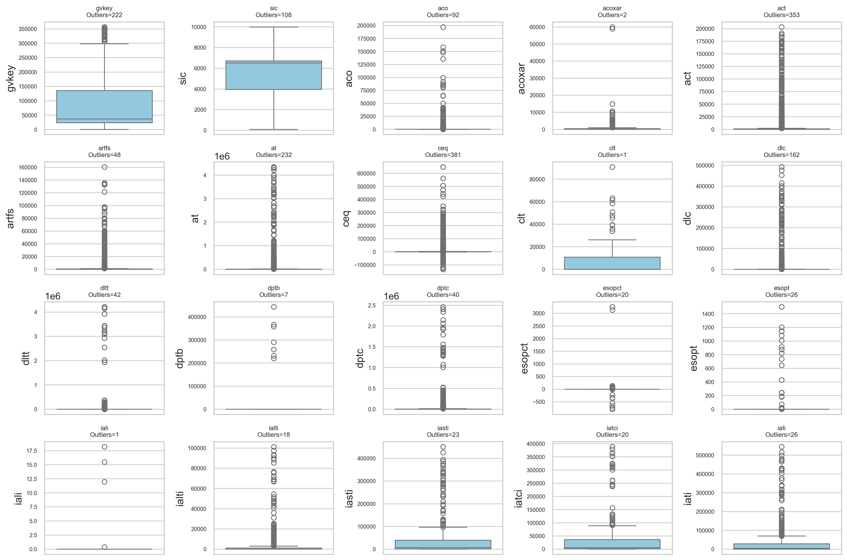
Data
Data
Boxplots of selected features
U.S. Corporate Bankruptcy Prediction

Slide 9
Data
Data
Description summary for selected numerical features
Log transformation
 | count | mean | std | min | 25% | 50% | 75% | max | skewness | kurtosis
lcat | 280.00 | 7286.79 | 38020.83 | 0.00 | 0.00 | 0.00 | 0.00 | 311448.00 | 6.29 | 40.18
dvt | 42636.00 | 156.10 | 835.28 | -709.00 | 0.00 | 0.00 | 36.00 | 25999.00 | 12.40 | 203.35
uopi | 1414.00 | 815.65 | 1124.10 | -3221.00 | 177.00 | 395.90 | 1011.00 | 9231.00 | 2.67 | 9.45
nits | 462.00 | 655.20 | 1288.71 | -3090.00 | 23.50 | 144.15 | 848.05 | 7713.00 | 2.36 | 7.61
artfs | 2499.00 | 2334.35 | 10414.77 | 0.00 | 23.93 | 104.14 | 514.04 | 160673.00 | 8.11 | 80.88
ialti | 575.00 | 4833.88 | 14706.52 | 0.00 | 0.00 | 0.00 | 1225.19 | 101294.00 | 4.38 | 20.20
lcabg | 386.00 | 5304.75 | 32527.43 | 0.00 | 0.00 | 0.00 | 0.00 | 311448.00 | 7.44 | 56.90
cnltbl | 527.00 | 2877.22 | 8324.58 | -0.01 | 0.00 | 152.32 | 1296.13 | 57646.00 | 4.32 | 19.85
ppent | 41529.00 | 1740.90 | 9394.63 | 0.00 | 4.06 | 37.59 | 344.87 | 328806.00 | 14.04 | 281.17
pltbl | 532.00 | 10105.54 | 34816.41 | -3354.00 | 0.00 | 0.00 | 1942.50 | 308810.00 | 5.16 | 30.80
idit | 25643.00 | 291.47 | 4182.15 | -16.00 | 0.00 | 0.60 | 15.00 | 193933.00 | 26.56 | 829.10
tstk | 42740.00 | 824.64 | 6587.93 | -26.22 | 0.00 | 0.00 | 7.44 | 254917.00 | 17.37 | 424.41
ptbl | 568.00 | 13957.84 | 34604.84 | -3354.00 | 453.14 | 1403.50 | 8188.25 | 308810.00 | 4.71 | 27.43
The entire description summary refers to overleaf table1
U.S. Corporate Bankruptcy Prediction

Slide 10
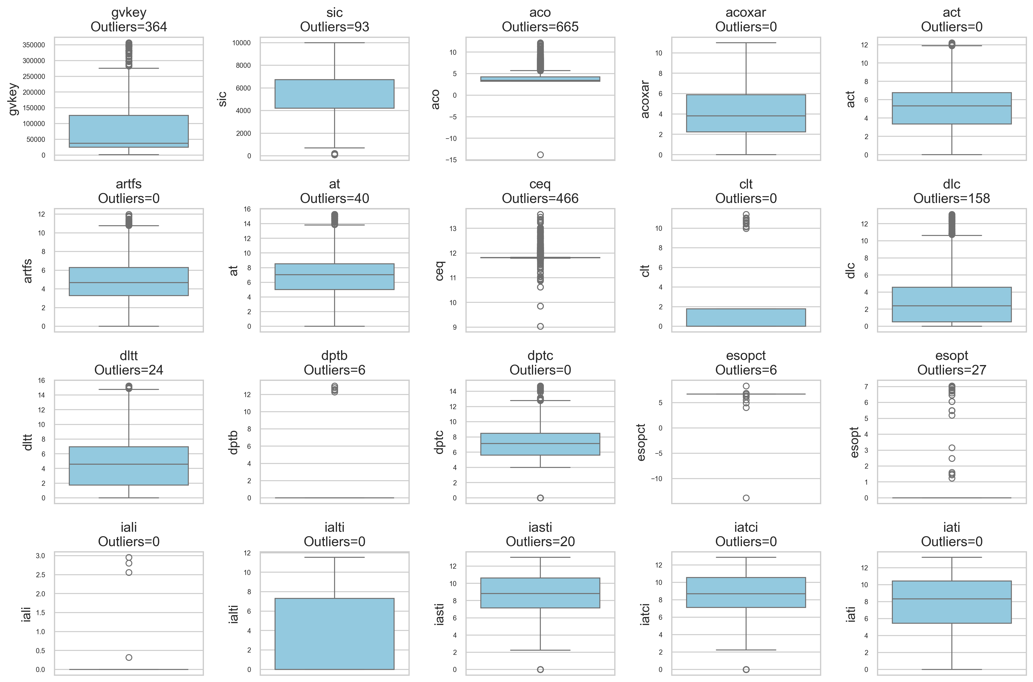
Data
Data
Boxplots of selected features (after log transform)
U.S. Corporate Bankruptcy Prediction

Slide 11
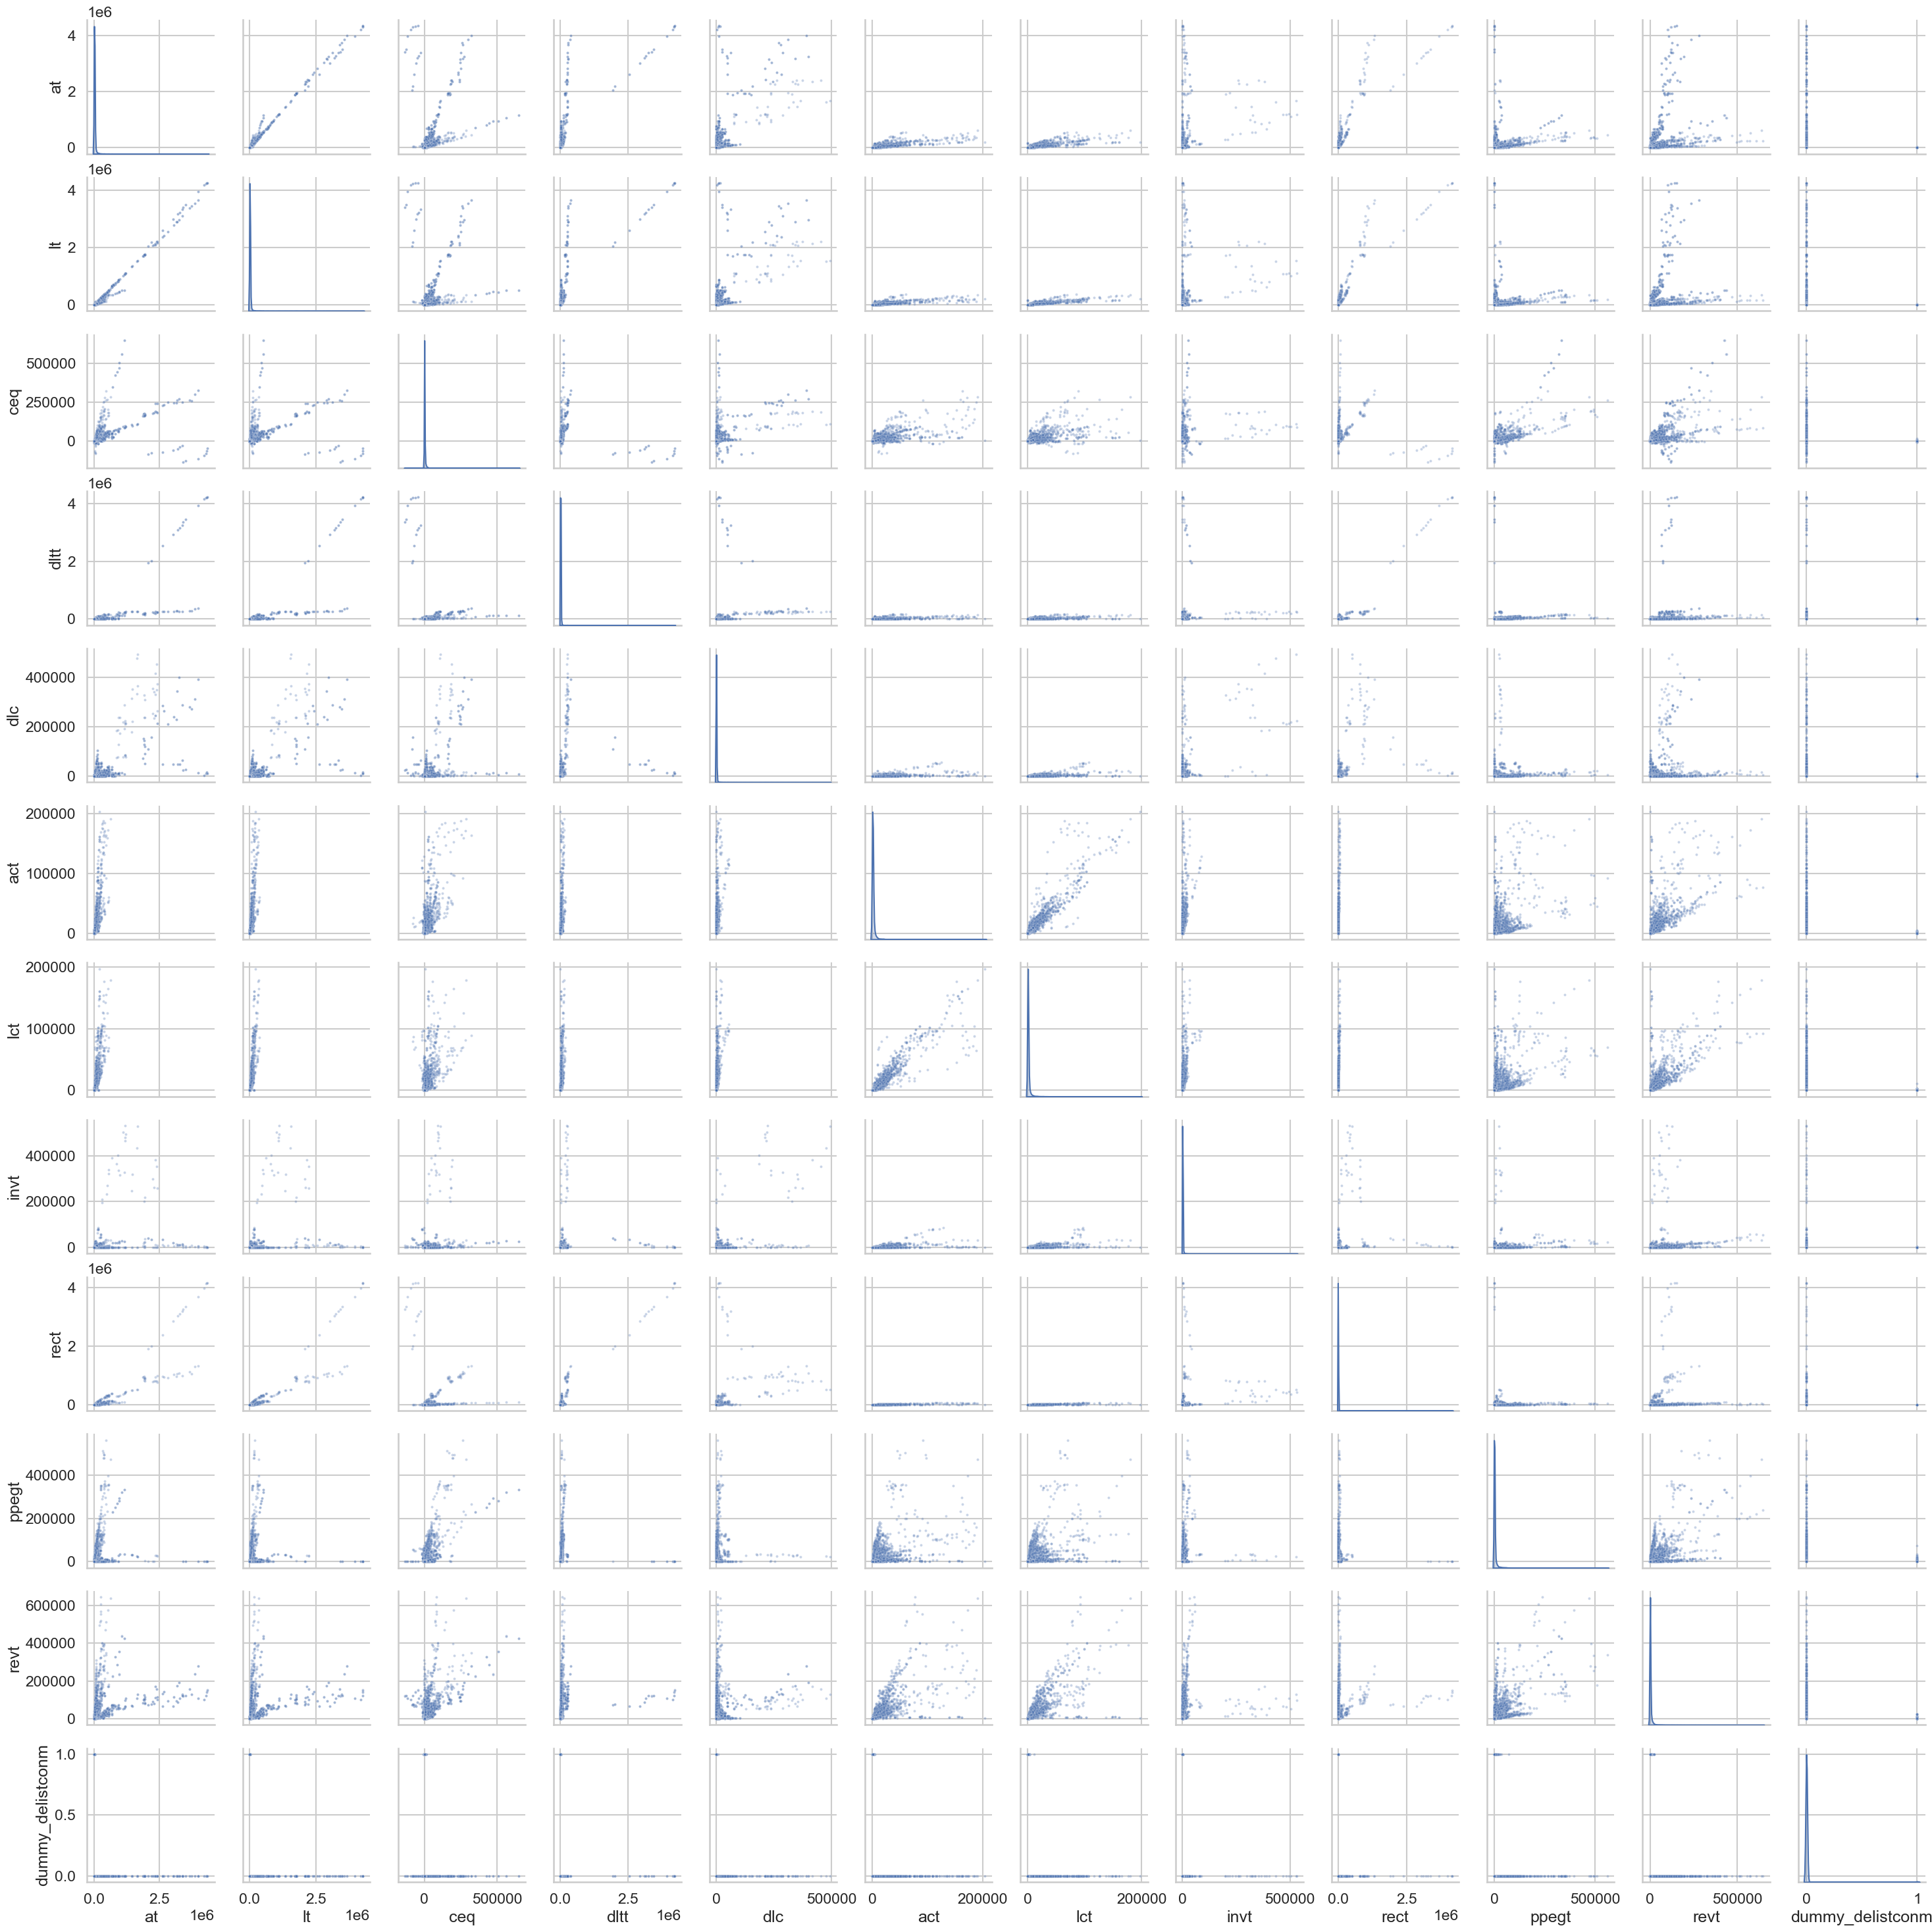
Data
Data
Pairplot of selected features
U.S. Corporate Bankruptcy Prediction

Slide 12
Data
Data
U.S. Corporate Bankruptcy Prediction

Slide 13
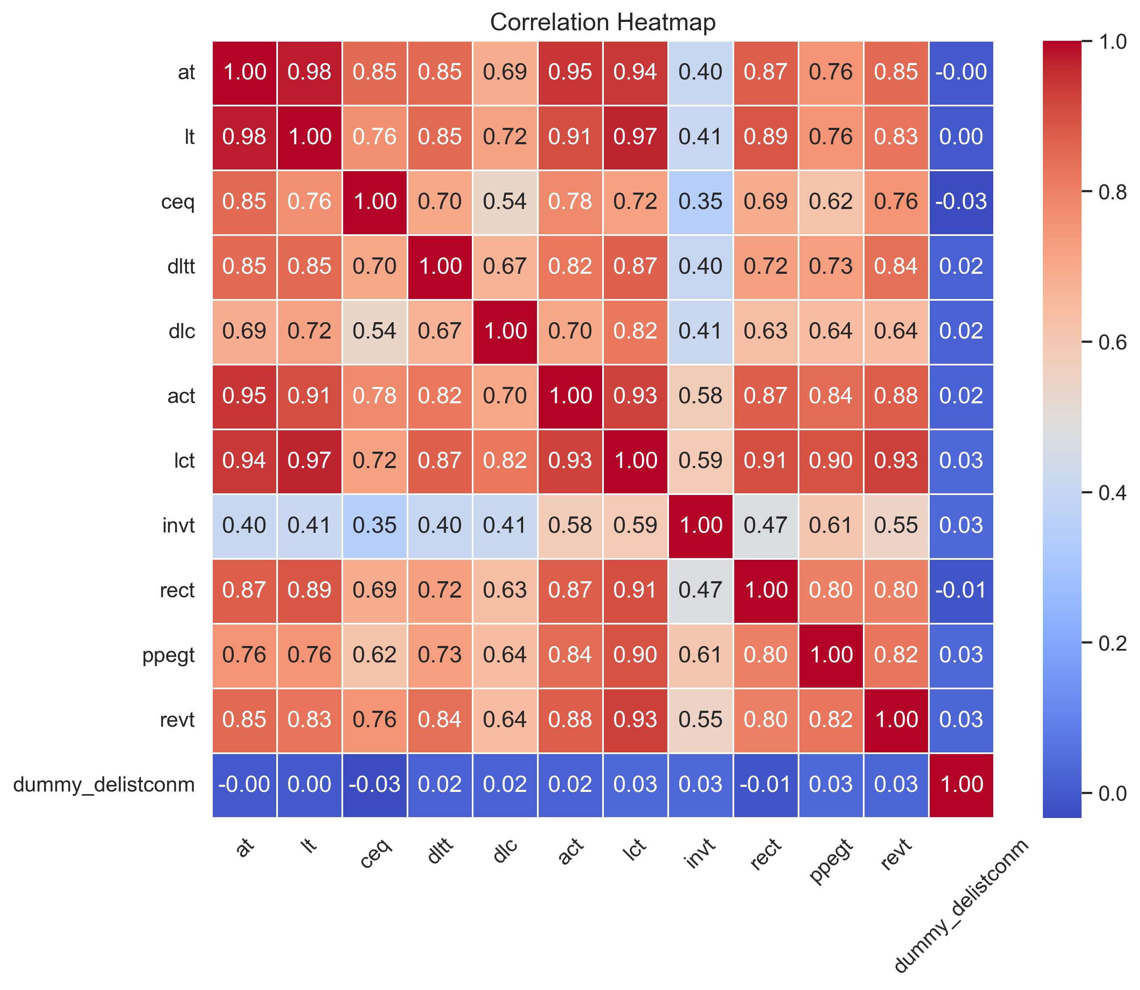
Data
Data
Heatmap of selected features
U.S. Corporate Bankruptcy Prediction

Slide 14
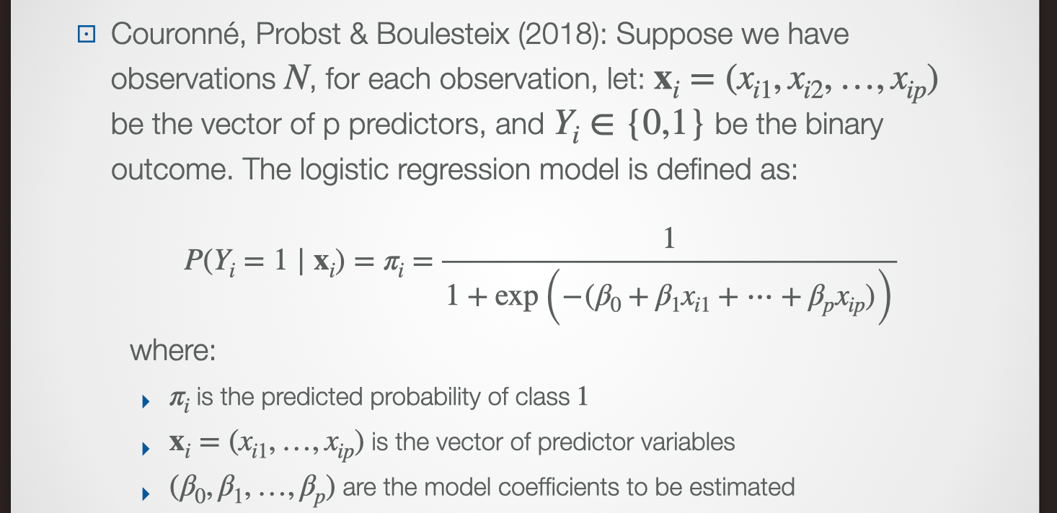
Methdology
Benchmark
Logistic Regression
U.S. Corporate Bankruptcy Prediction

Slide 15
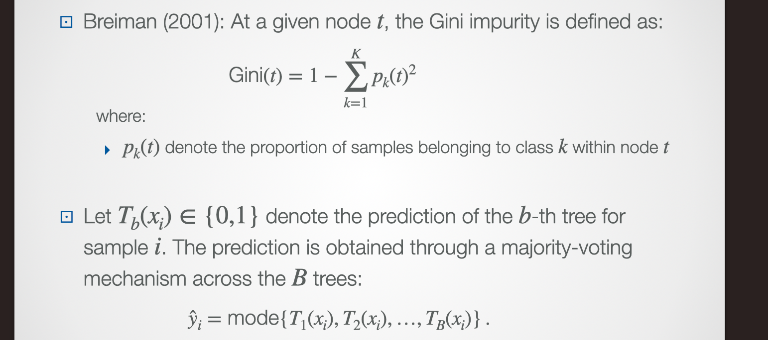
Methdology
Machine Learning Model
Random forest
U.S. Corporate Bankruptcy Prediction

Slide 16
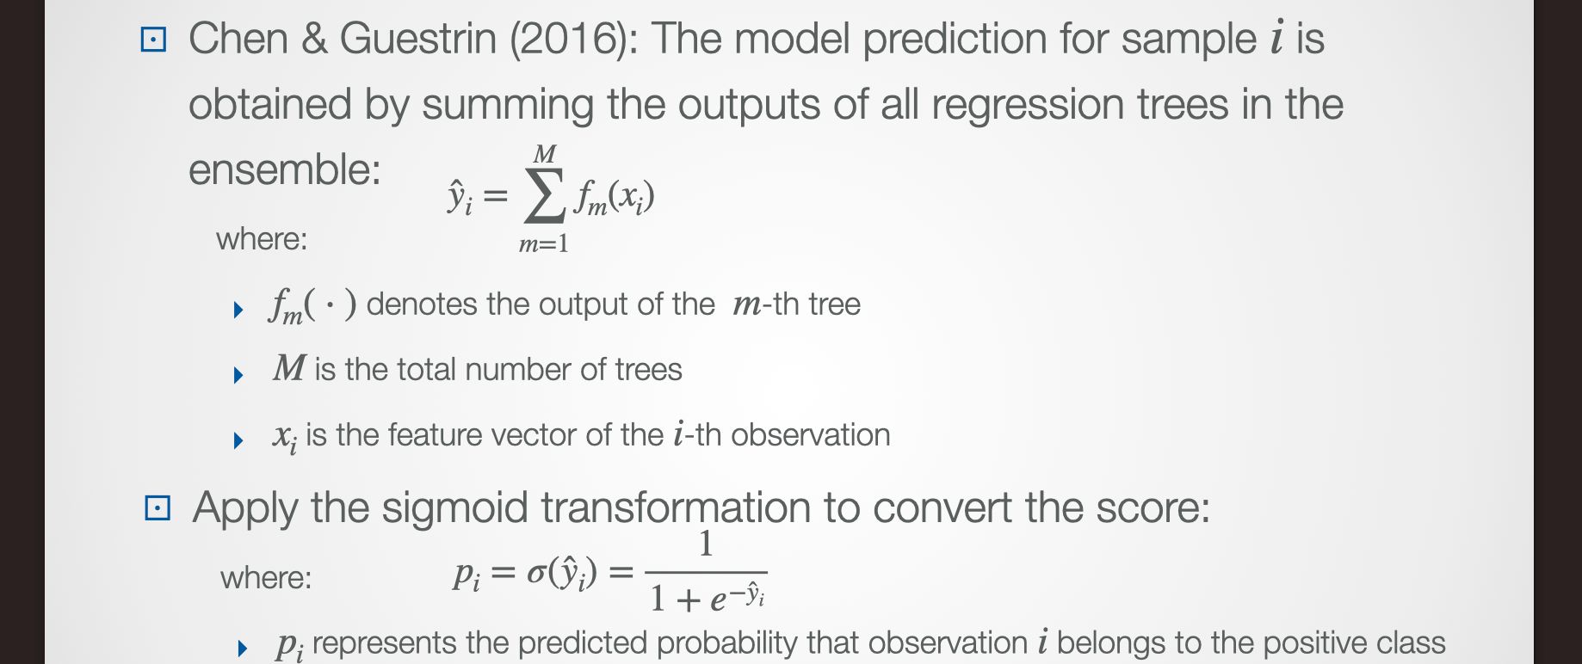
Methdology
Machine Learning Model
XGBoost
U.S. Corporate Bankruptcy Prediction

Slide 17
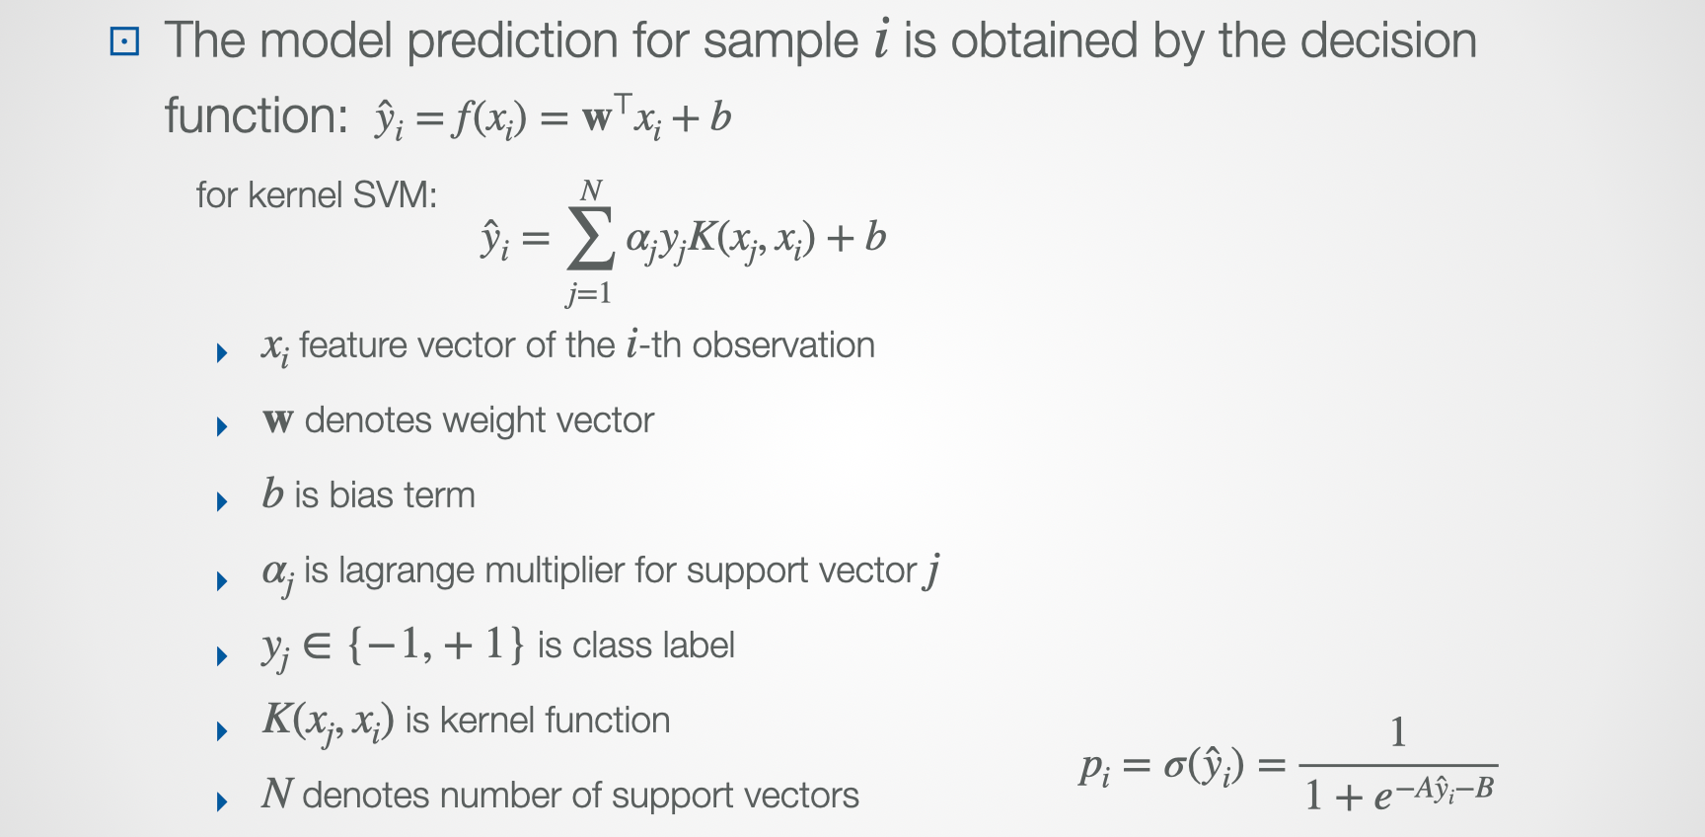
Methdology
Machine Learning Model
SVM
Apply the sigmoid transformation to convert the score into probability
U.S. Corporate Bankruptcy Prediction

Slide 18
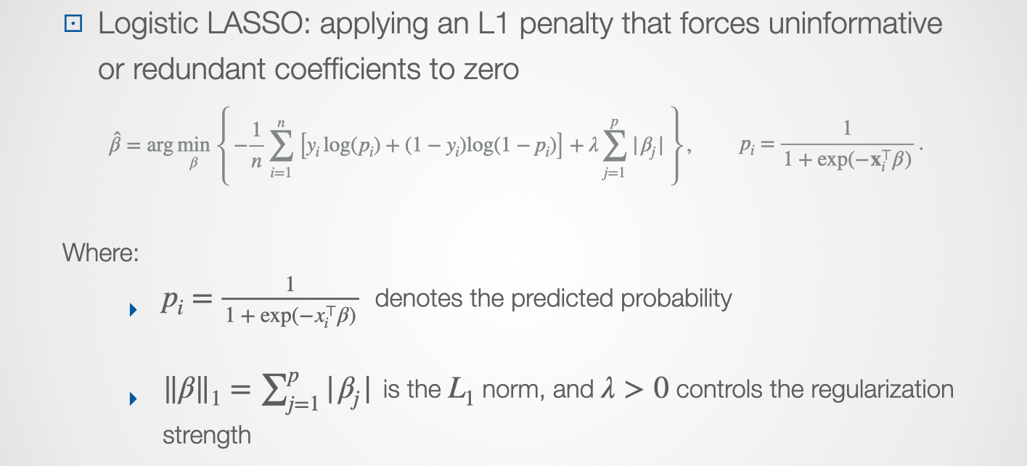
Methdology
Feature Selection Model
LASSO
U.S. Corporate Bankruptcy Prediction

Slide 19
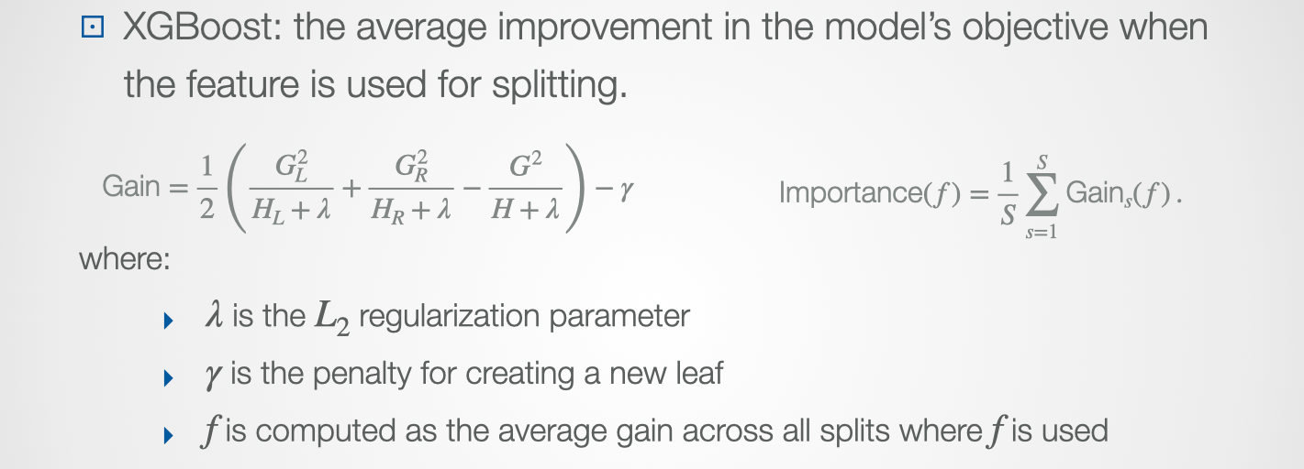
Methdology
Feature Selection Model
XGBoost
U.S. Corporate Bankruptcy Prediction

Slide 20
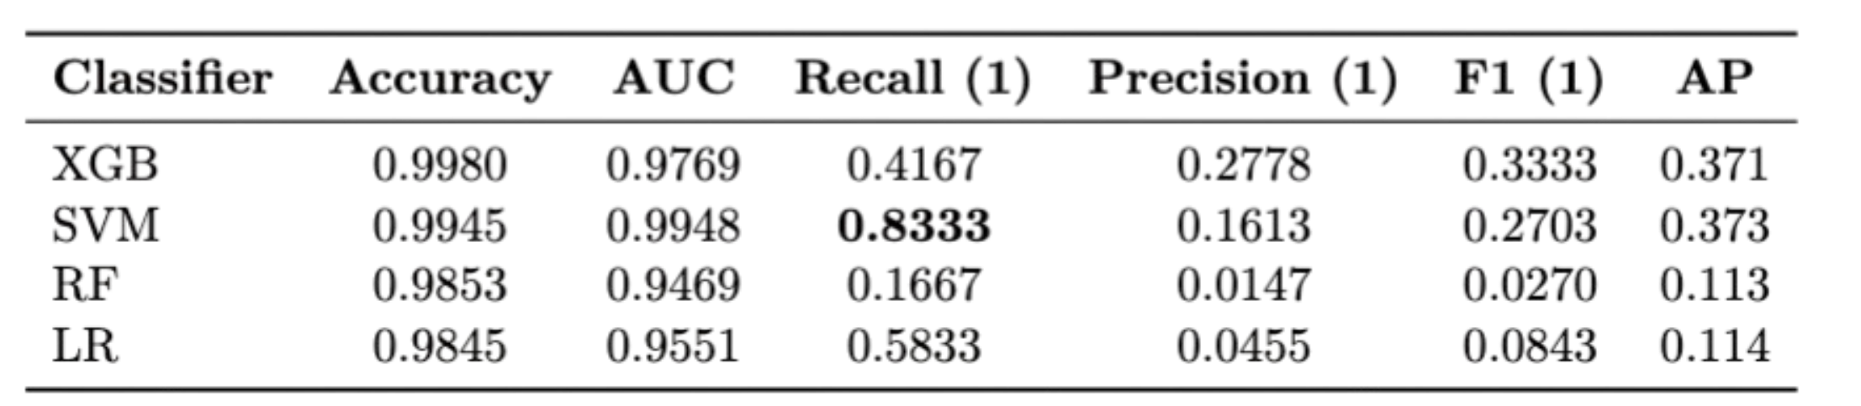
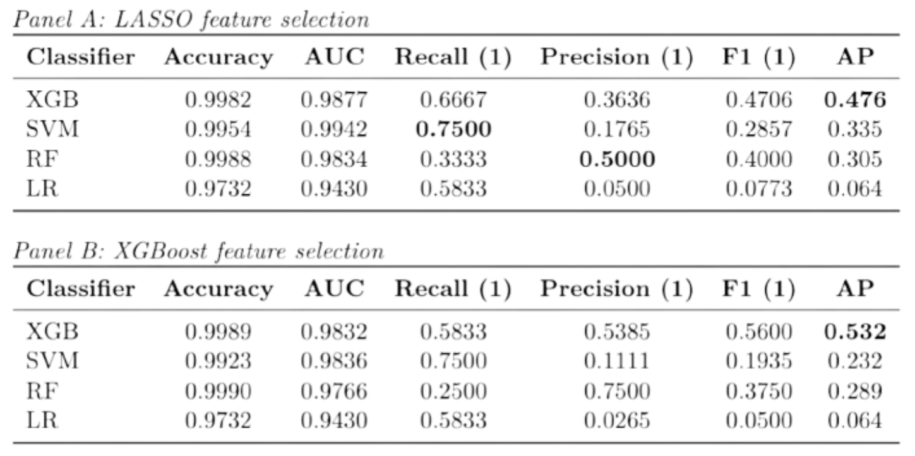
Result
Results
U.S. Corporate Bankruptcy Prediction

Slide 21
Result
Conclusion
XGBoost performs more stable under feature selection and no selection
SVM has higher recall but lower precision, and with little improvement after feature selection
RF and XGB perform better with feature selection
LR has higher AP without feature selections
Missing-value indicators disclosure as a distress signal
U.S. Corporate Bankruptcy Prediction

Slide 22
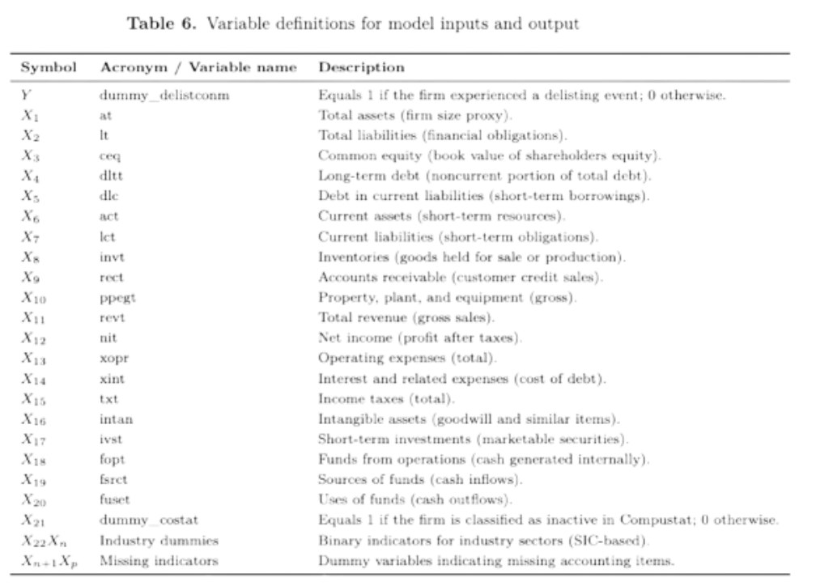
Methdology
Model input and output
LASSO feature selection
U.S. Corporate Bankruptcy Prediction

Slide 23
Imbalance-Aware Feature Selection and Machine
Learning for U.S. Corporate Bankruptcy Prediction
Yun-Chen Li, Rou-Rou Yu, Yi-An Chen, Huei-Wen Tung
20251013 BP.key

